Slide 1
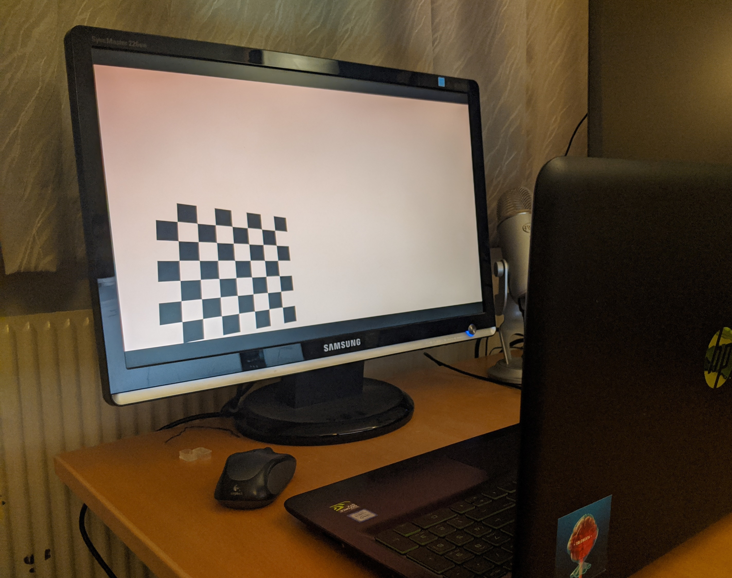
Automatic Camera Calibration Using Video

Slide 2
Project Proposal
Camera calibration is an annoying process.
Remove the manual step with a physical chessboard
Instead use a video to calibrate from
Use Non-Linear algorithm to optimize parameters

Slide 3
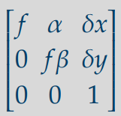
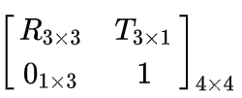
Extrinsic and Intrinsic Camera Parameters
Direct Linear Transformations
Zhangs method

Slide 4
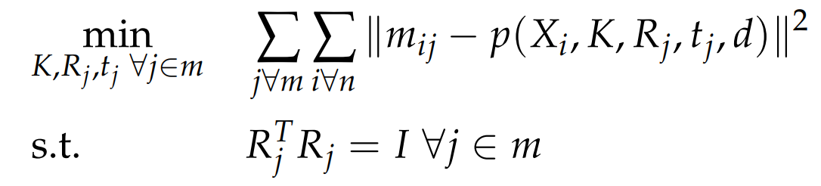
Non-Linear Algorithm for Estimating parameters

Slide 5
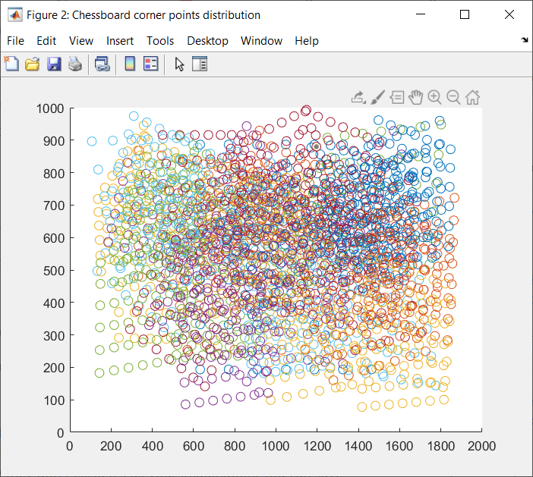
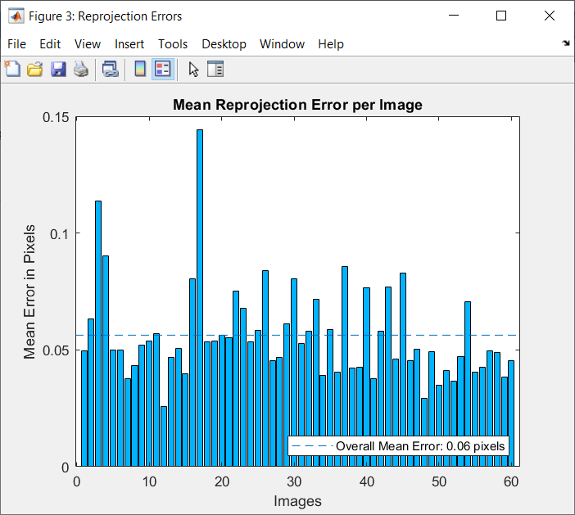
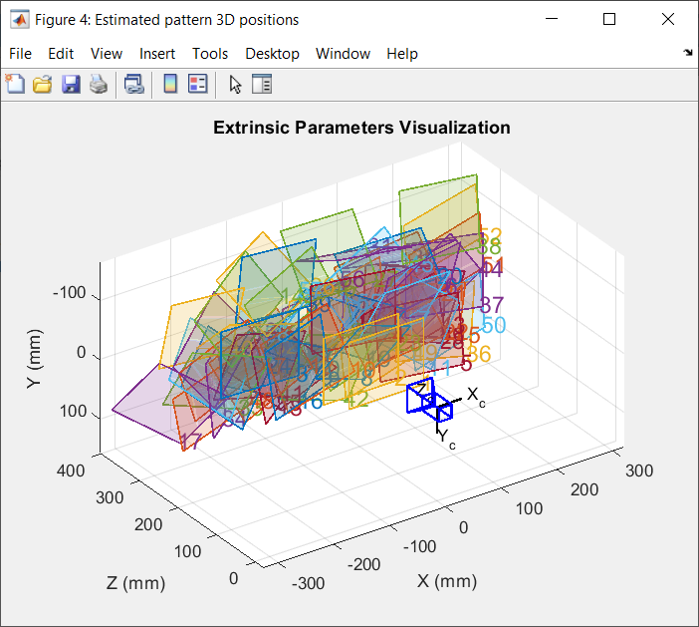
Results

